Slide 1
Important Terms to know as a AI Engineer
BY:Muhammad Mehmood Ahmed

Slide 2
Bias vs Variance
Bias is the difference between the average prediction of our model and the correct value which we are trying to predict.
Model with high bias pays very little attention to the training data and oversimplifies the model
It always leads to high error on training and test data.

Slide 3
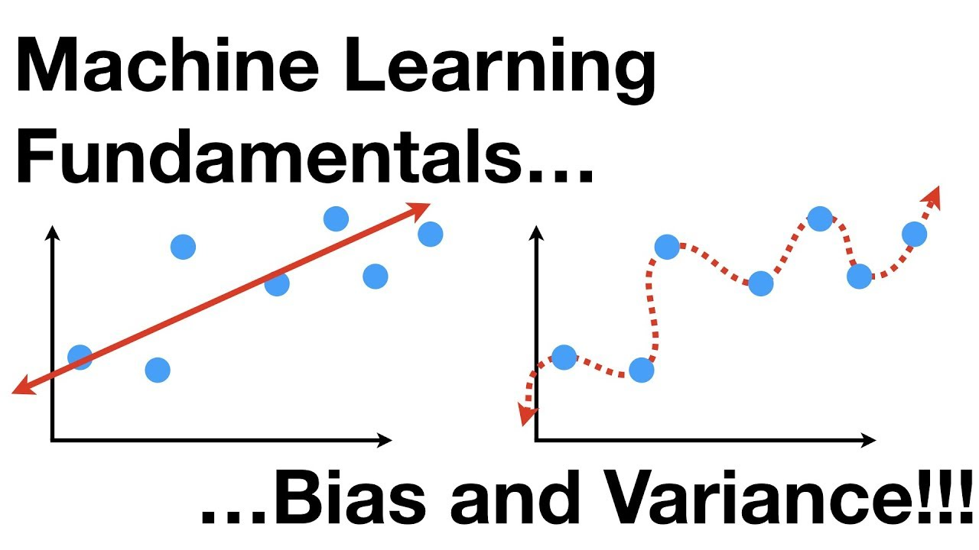
Bias:
Bias=E[θ^]−θ.

Slide 4
Variance
Variance is the variability of model prediction for a given data point or a value which tells us spread of our data.
Model with high variance pays a lot of attention to training data and does not generalize on the data which it hasn’t seen before.
such models perform very well on training data but has high error rates on test data.

Slide 5
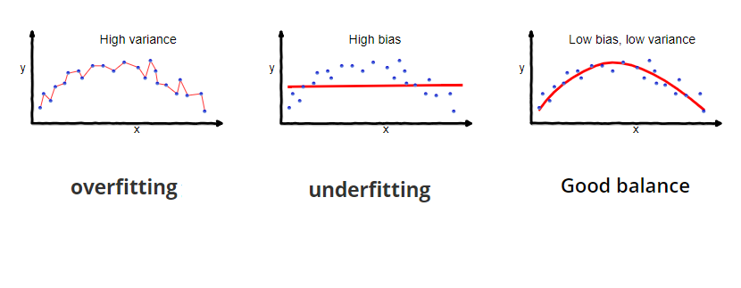
Variance
Var(θ^)=E[(E[θ^]−θ^)²]
.

Slide 6
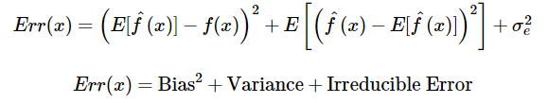
Trade-off

Slide 7
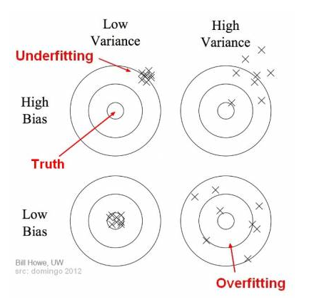
Trade-off

Slide 8
From data point of view
Small Data set
Bias =high Variance =Low
Large data set
Bias =Low Variance =High

Slide 9
Train, test split
The train-test split is a technique for evaluating the performance of a machine learning algorithm.
It can be used for classification or regression problems and can be used for any supervised learning algorithm

Slide 10
Train Dataset:
Used to fit the machine learning model.
Test Dataset:
Used to evaluate the fit machine learning model
The train-test split procedure is appropriate when you have a very large dataset, a costly model to train, or require a good estimate of model performance quickly.

Slide 11
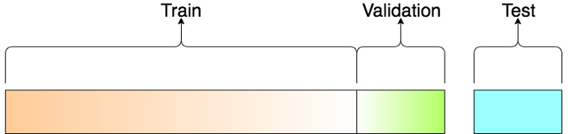
Train ,Test and Validation

Slide 12
Hyper-parameter tuning
In machine learning, hyperparameter optimization or tuning is the problem of choosing a set of optimal hyperparameters for a learning algorithm
hyperparameter is a parameter whose value is used to control the learning process.

Slide 13
Hyper-parameter
A model hyperparameter is a configuration that is external to the model and whose value cannot be estimated from data.
They are often used in processes to help estimate model parameters.
They are often specified by the practitioner.
They are often tuned for a given predictive modeling problem.

Slide 14
K-fold cross validation
Cross-validation is a resampling procedure used to evaluate machine learning models on a limited data sample.
The procedure has a single parameter called k that refers to the number of groups that a given data sample is to be split into.

Slide 15
The general procedure is as follows:
Shuffle the dataset randomly.
Split the dataset into k groups
For each unique group:
Take the group as a hold out or test data set

Slide 16
Take the remaining groups as a training data set
Fit a model on the training set and evaluate it on the test set
Retain the evaluation score and discard the model
Summarize the skill of the model using the sample of model evaluation scores

Slide 17
Example:
[0.1, 0.2, 0.3, 0.4, 0.5, 0.6]
we will use a value of k=3.
Fold1: [0.5, 0.2]
Fold2: [0.1, 0.3]
Fold3: [0.4, 0.6]
Model1: Trained on Fold1 + Fold2, Tested on Fold3
Model2: Trained on Fold2 + Fold3, Tested on Fold1
Model3: Trained on Fold1 + Fold3, Tested on Fold2

